Slide 1

CIT-2180 Data and Database Management Chapter 12

Slide 2

Oracle 12c: SQL
Chapter 12
Subqueries

Slide 3
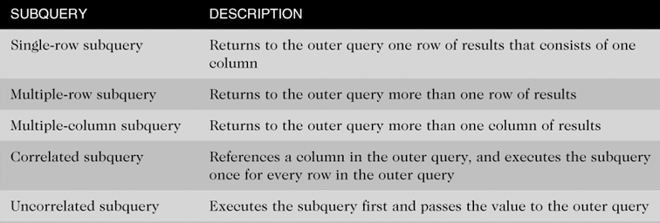
Types of Subqueries
3

Slide 4
Subqueries and Their Uses
Subquery – a query (called the inner query) nested inside another query (called the outer query)
Used when a query is based on an unknown value
Requires SELECT and FROM clauses – must be a complete SQL SELECT with no ORDER BY clause
Must be enclosed in parentheses
Place on right side of comparison operator
4

Slide 5
Subqueries and Their Uses
Single-row sub-queries can be nested in
SELECT
FROM (creates a temporary table – inline view)
WHERE
HAVING
Multi-row and multi-column sub-queries can be nested in
FROM (creates a temporary table – inline view)
WHERE
HAVING
5

Slide 6
Single-Row (single-value) Subqueries
Return one row of results, and only one column.
When used in a WHERE clause, the operators include =, >, <, >=, <=, < >

Slide 7
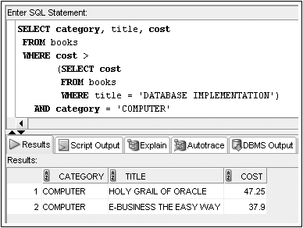
Single-Row Subquery - WHERE Clause
Used for comparison against individual data
Provide a list of all “COMPUTER” books whose cost is greater than the one titled “DATABASE IMPLEMENTATION”.

Slide 8
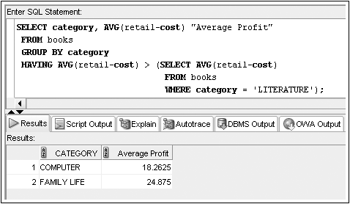
Single-Row Subquery - HAVING Clause
Required when returned value compared to grouped data
Provide a list of all book categories returning a higher average profit than the LITERATURE category.

Slide 9
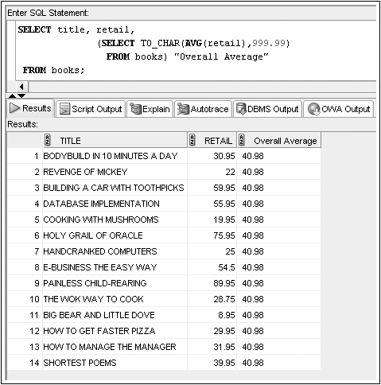
Single-Row Subquery - SELECT Clause
Replicates subquery value for each row displayed

Slide 10
Single-Row Subquery Example #1
What is the book that has the highest retail value?
SELECT title, retail
FROM books
WHERE retail =
(SELECT MAX(retail) FROM books);
The following will not work, why?
SELECT title, max(retail)
FROM books;

Slide 11
Single-Row Subquery Example #2
What is the title of all books published by the publisher of “Big Bear and Little Dove” that generate more than the average profit returned by all books?
SELECT isbn, title
FROM books
WHERE pubid =
(SELECT pubid FROM books WHERE title =
'BIG BEAR AND LITTLE DOVE')
AND retail-cost >
(SELECT AVG(retail-cost) FROM books);

Slide 12
Single-Row Subquery Example #3
What is the list of all book categories returning a higher average profit than the ‘COMPUTER’ category (based on the book retail value)?
SELECT category, AVG(retail-cost) "Average Profit"
FROM books
GROUP BY category
HAVING AVG(retail-cost) >
(SELECT AVG(retail-cost) FROM books
WHERE category = 'COMPUTER');

Slide 13
Single-Row Subquery Example #4
Compare the price of each book in inventory against the average price of all books in inventory.
SELECT title, retail, retail-
(SELECT TO_CHAR(AVG(retail), 999.99)
FROM books)
FROM books;

Slide 14
Multiple-Row Subqueries
Return more than one row of results, but only one column.
Most commonly used in WHERE and HAVING clauses
Require use of IN, ANY, ALL, or EXISTS operators

Slide 15
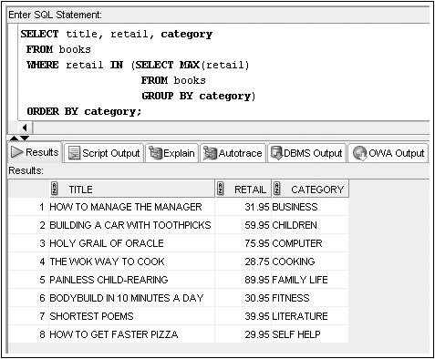
Multiple-Row Subquery - WHERE Clause
Books with a retail value matching the highest retail value for any book category.
15

Slide 16
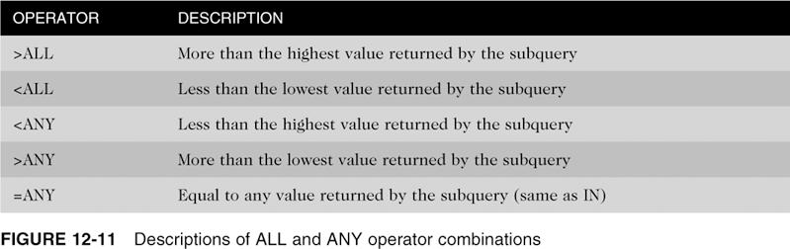
ANY and ALL Operators
Combine with arithmetic operators
NOTE: The MIN() and MAX() operators can be used to accomplish similar tasks.

Slide 17
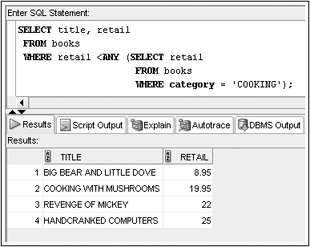
Multiple-Row Subquery - WHERE Clause
Find books priced lower than the least expensive book in the ‘COOKING’ category.
17

Slide 18
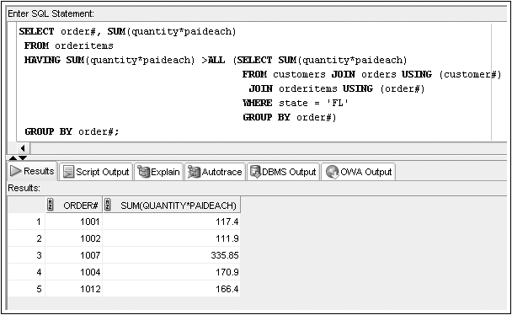
Multiple-Row Subquery - HAVING Clause
Determine whether any customer’s recently placed order has a total amount due greater than the total amount due for every order placed recently by Florida customers !!!
18

Slide 19
Multiple-Column Subqueries
Return more than one column in results
Can return more than one row
Column list on the left side of operator must be in parentheses
Use the IN operator for WHERE and HAVING clauses
19

Slide 20
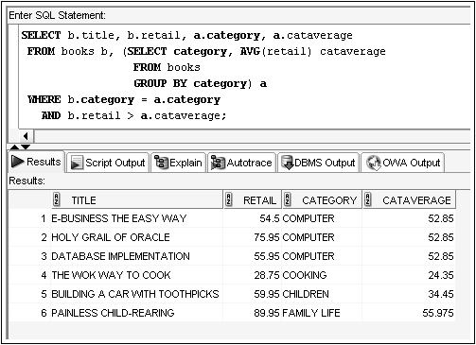
Multiple-Column Subquery - FROM Clause
Creates a temporary table (this is a join)
List all books that have a higher-than-average selling price compared with other books in the same category.

Slide 21
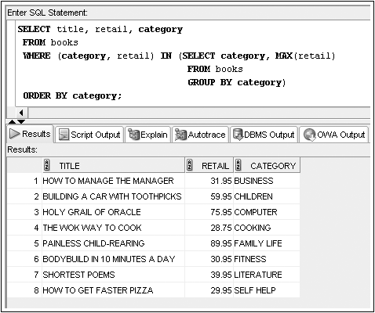
Multiple-Column Subquery - WHERE Clause
Returns multiple columns for evaluation
List the most expensive books in each category

Slide 22
Nested Subqueries
Maximum of 255 subqueries if nested in the WHERE clause
No limit if nested in the FROM clause
Innermost subquery is resolved first, then the next level, etc.
22

Slide 23
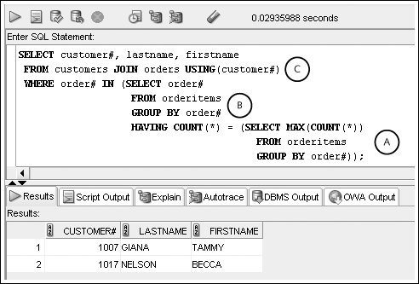
Nested Subqueries (continued)
Innermost is resolved first (A), then the second level (B), then the outer query (C)

Slide 24
Topics not Discussed
We will not cover pages 473 – 474, 477-483
CORRELATED SUBQUERIES
SUBQUERY FACTORING CLAUSE
DML ACTIONS WITHIN SUBQUERIES
MERGE

Slide 25
Oracle 12c: SQL
END OF Chapter 12
Subqueries

